Slide 1
Emergen | Sim
Data Analysis and Simulation Modeling for Optimizing Urban Emergency Response Systems
By Surya Chand Rayala

Slide 2
The Dataset

Slide 3
overview of the project
This project focuses on creating a data driven Emergency Response Environment, an advanced simulation framework designed for enhancing urban emergency response tactics. By leveraging a comprehensive dataset, I have developed a dynamic 30x30 grid simulator. This tool not only incorporates data analysis and probabilistic modeling to realistically simulate incidents but also tracks various response strategies and assigns rewards based on their effectiveness.

Slide 4
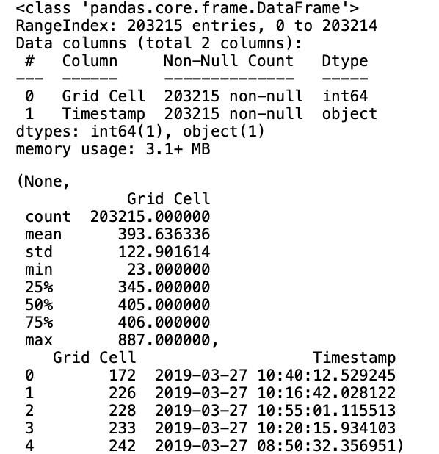
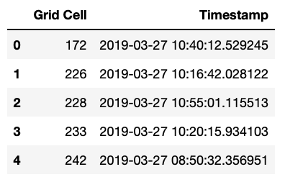
The Dataset
The dataset given consists of two columns — 'Grid Cell' and 'Timestamp'.
This dataset represents incidents recorded in different grid cells, with each entry comprising a grid cell identifier and a timestamp.

Slide 5
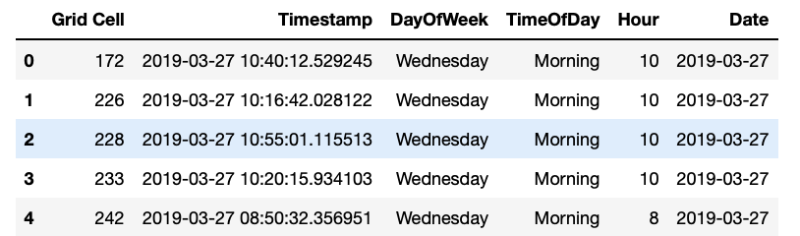
Transforming Data into Insights (Pre-Processing)
Convert the 'Timestamp' column to datetime format and extract features like DayOfWeek, Hour, Date. Then Defined and applied a function categorize_time_of_day to classify hours into 'Morning', 'Afternoon', 'Evening', or 'Night'..

Slide 6
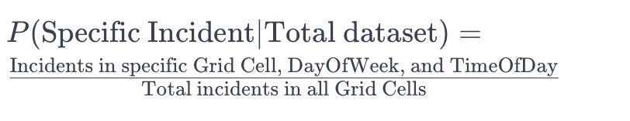
Calculating Incident Probabilities
For every grid cell the probability for an incident to occur is calculated by using the Formula:

Slide 7
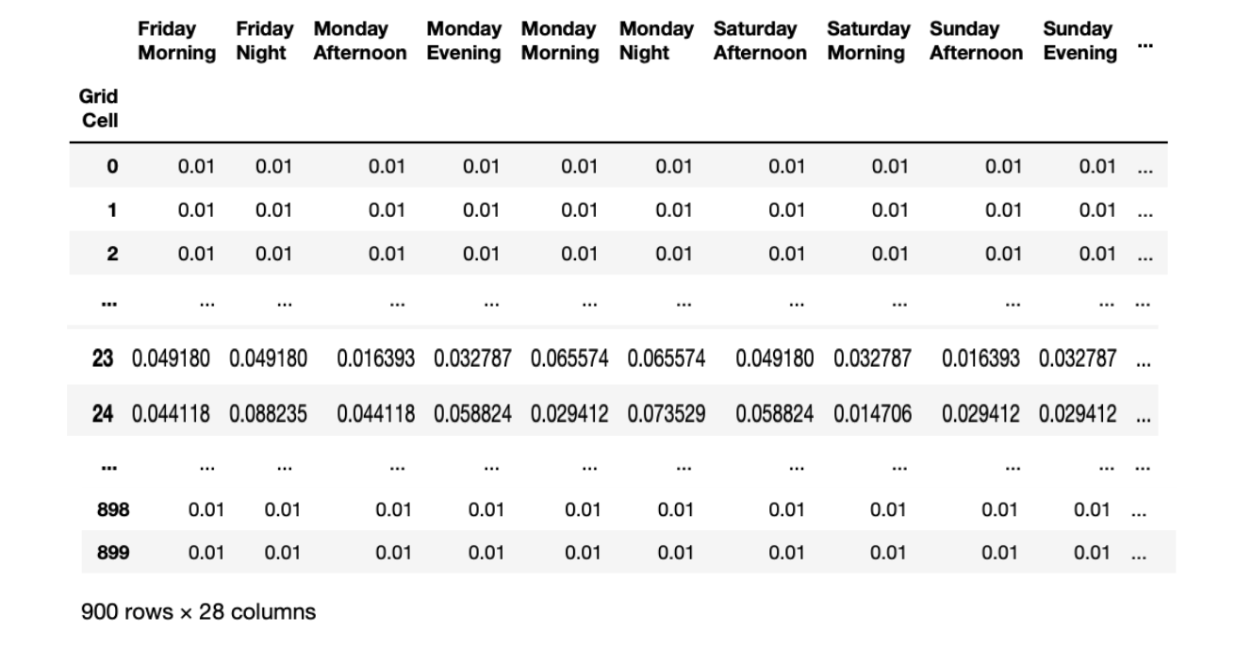
Completed Dataframe(Ready for the Environment)
Calculated incident probabilities for each grid cell across all times and days, and interpolated grid cells with no events. The result is a concise Incident Probability DataFrame, highlighting incident likelihoods across the grid.

Slide 8
The Environment

Slide 9
State and Action Space
State Space:
Represented as a vector mapping the grid.
Each element denotes the severity level of incidents at specific locations.
Action Space:
Defined by the grid cell numbers for each available resource.
Decisions involve choosing which grid cell each resource should be deployed to.

Slide 10
Resource Characteristics
Realistic Resource Constraints:
The simulation incorporates realistic limitations for each type of emergency resource (e.g., ’A’, ’B’).
These constraints include operational ranges (effective distances from their stations) and specialization in handling specific severity levels of incidents.

Slide 11
Initializing the Environment
The simulation is influenced by the following key inputs:
The Incident probabilities dataset in the aforementioned format.
time chunk (e.g., morning, afternoon) and day of the week.
configurations of emergency resources, each with unique types and initial stationing.

Slide 12
Process of Incident Simulation
Decision Cycle Initiation:
Each simulation Episode starts with a decision cycle to generate incidents.
Random Sampling for Incidents:
Random values are sampled for each grid cell.
Comparing Against Probabilities:
These values are compared with predefined probabilities, reflecting historical incident patterns and temporal variations.
Incident Generation:
If a sampled value is below the grid cell's threshold probability, an incident is generated in that cell.
Severity Level Determination:
The severity of each incident is assigned randomly, based on predefined likelihoods of different severity levels.
Outcome:
This process results in a realistic and varied set of incidents, simulating the unpredictability of real-world emergency situations.

Slide 13
Resource Movement and Incident Response
Resources are moved to the grid cells as per the actions taken. For each resource, the code checks if it's moved to a cell with an active incident.
If a resource encounters an incident, the code evaluates whether the resource type is capable of addressing the incident based on its type and severity.
The simulator also calculate the travel time for each resource to reach its designated grid cell. This as of now is based on Manhattan distance.

Slide 14
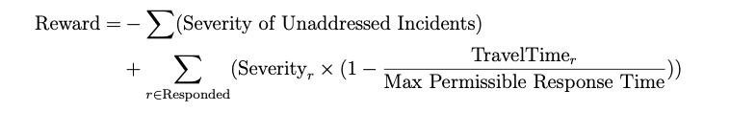
Reward Function

Slide 15
Outputs of Sample Simulation Run

Slide 16
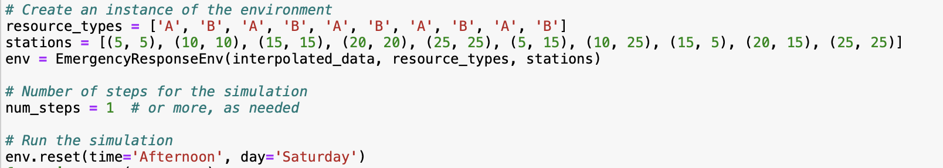
In the given simulation configuration, ten ambulances, categorized as either type 'A' or 'B' and assigned specific station coordinates, are integrated into the environment.

Slide 17
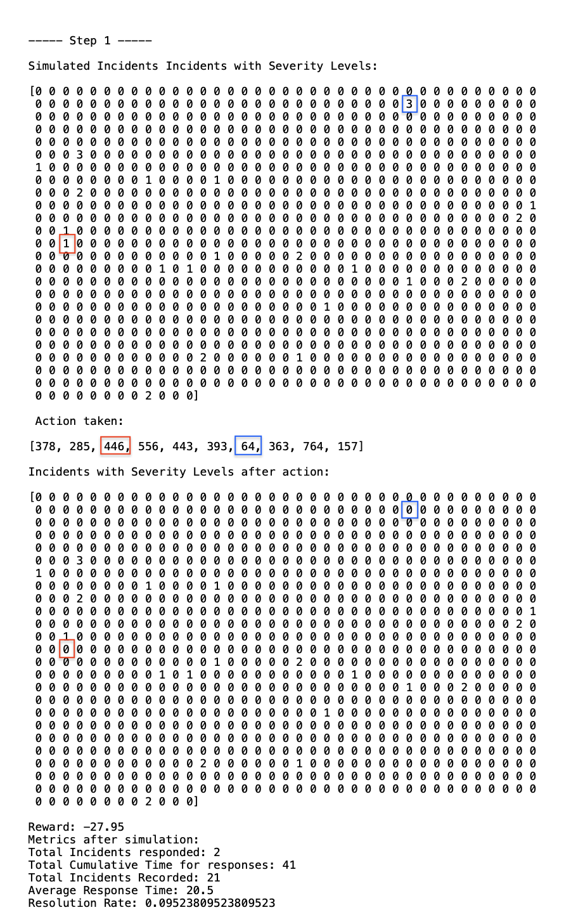

Slide 18
Applying Reinforcement Learning

Slide 19
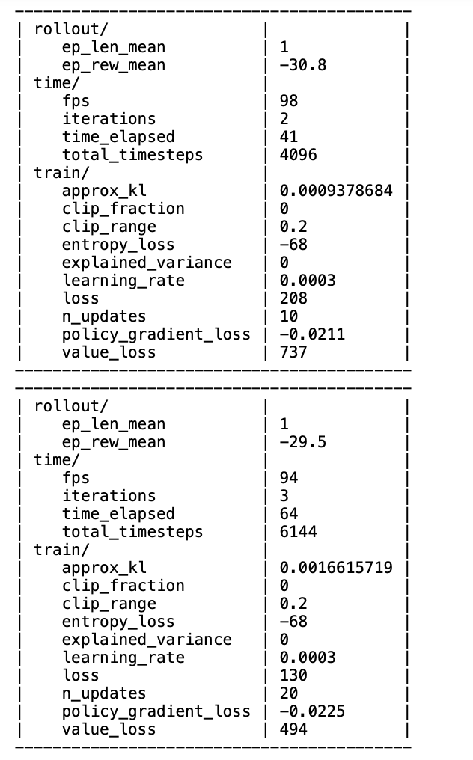
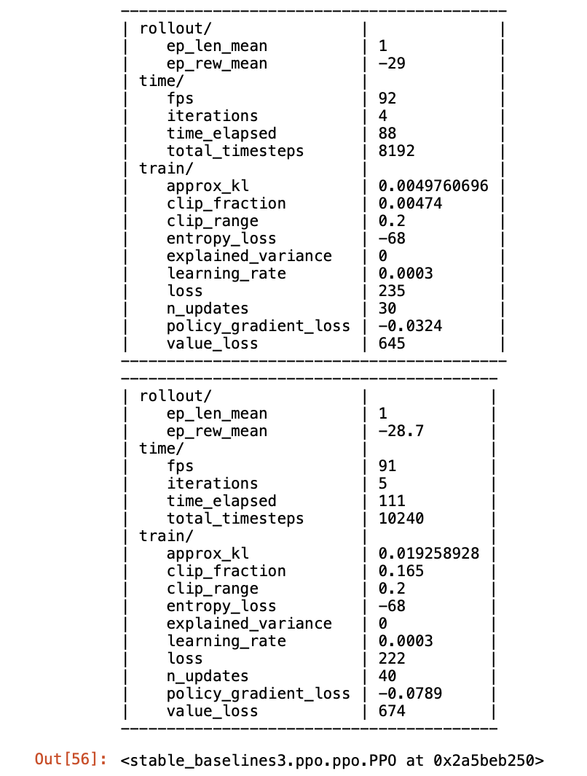
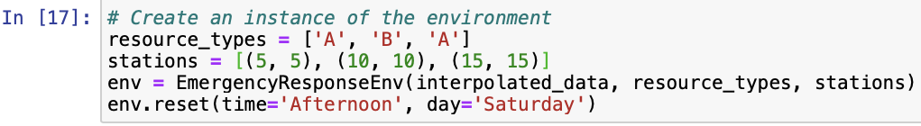
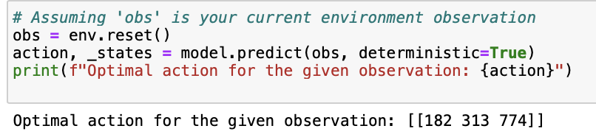
Configured Environment to work with PPO (Proximal Policy Optimization)
PPO Learning
Configuration of the environment
Predicting From Saved PPO Model

Slide 20
Future Work

Slide 21
Attempt to enhance the learning process by increasing the number of steps per episode and allocating more resources. Concentrate on a subset of grid cells instead of all 900 and assess the model's performance.
If, despite these adjustments, the improvement at each time step is still not satisfactory, it will be necessary to revisit and modify the reward function and other constraints that were initially defined.

